Slide 1

Going Reactive With Java 8
View What's new in Java 8 course details at www.edureka.co/java-8
For Queries:
Post on Twitter @edurekaIN: #askEdureka
Post on Facebook /edurekaIN
For more details please contact us:
US : 1800 275 9730 (toll free)
INDIA : +91 88808 62004
Email Us : webinars@edureka.co

Slide 2
Objectives
At the end of this webinar, you will be able to:
Understand Why Java 8 Came into Picture
Know Hot Topics in Java 8
Demo on Java 8

Slide 3
Quick TimeLine of Java
Java 1.0
Java 2.0
Java 5.0
Java
7.0
Java 8.0
-Functional Programming
-Enhanced Exception –Handling
-Streams Introduced
-New Time and Date API
-More Power
-Major Syntactical changes
-More friendlier
-Language of Choice for Enterprise
-Iterators introduced
-Generics Introduced
-Concurrency Support
-Nashorn JS engine
-Much Faster, Better GUI Support
-J2EE, J2ME, J2SE introduced
-Became popular for Web based projects
-Humble Beginnings
-Very Few Classes
-Slow
-Applets were a BIG Thing!

Slide 4
Drivers of Change..
Java started as a well designed object-oriented language
It had the support for many in-built libraries
Small scale concurrency support from first day itself- through support for threads and locks
It was platform independent- decision to compile Java to JVM bytecode a game changer
This made Java a preferred choice for internet based applications- which needed to run across platforms
Eventually many JVM based languages like Scala, Groovy etc. emerged
They run smoothly on JVM and can integrate easily with existing Java code
Java also evolved for entire spectrum from Embedded devices to Enterprise platforms over period of new releases
But…..

Slide 5
Drivers of Change..
Times are changing
With the machines being way powerful, our requirements to generate and process data are also increasing
Today programmers have to deal with Big data (Terabytes+ data) problems
It requires exploitation of multi core computers and enterprise computing grids
Effectively it calls for parallel processing, which was not Java’s favorite playground in past
With the advent of parallel processing algorithms and platforms, the programming paradigms started changing
The old style Java was still able to support it (think Native Map reduce etc.), but it was not natural
Many times, programming parallel processing algorithms in Java becomes a serious pain
And…..

Slide 6
Drivers of Change..
Eventually many specialized languages for parallel processing started emerging e.g. Scala, R, Python etc.
Hence Java needed to change once again to adapt itself and be relevant with changing requirements of programmers
Over the period of time, many programming languages have give the programmers a very concise (and many times declarative) way of coding
Java embraced most of these changes with Java 8
This release has the biggest footprint in language functionality change. Let’s explore new programming concepts in bit more details!

Slide 7
Putting it All together
Java has gone through evolution in past as well
E.g. Using ArrayList<String> was uncomfortable as compared to ArrayList, but it brought it’s own benefits
Some other changes resulted in easier to read code, e.g. For each loops brought a lot of readability and remove the boilerplate code
Prior Java versions focused on object oriented programming approach , which relies on mutating existing objects
Java 8 moves towards the functional-style programming, where the programming style becomes more declarative in nature as compared to procedural in previous versions

Slide 8


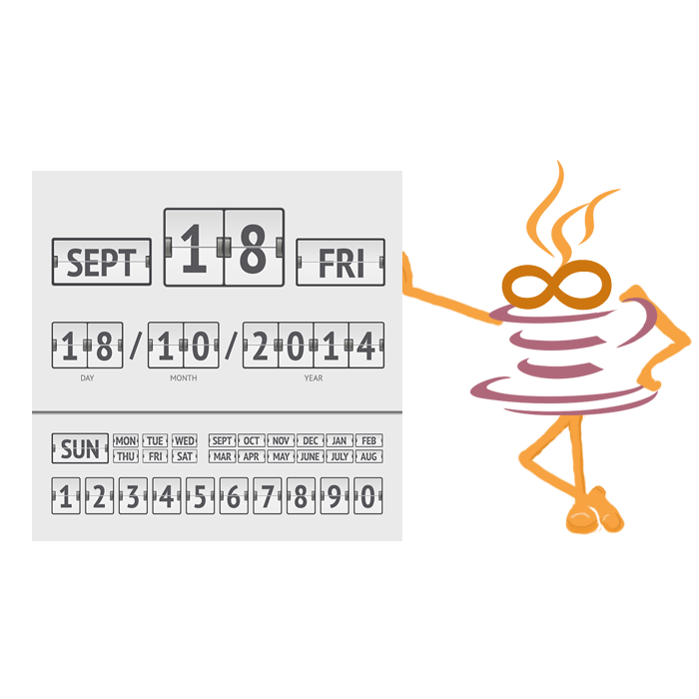
Hot Topics in Java 8 !!
Lambdas
Streams
New Date and Time API
Default Methods
Functional Interfaces

Slide 9

Demo on Java 8

